Slide 1
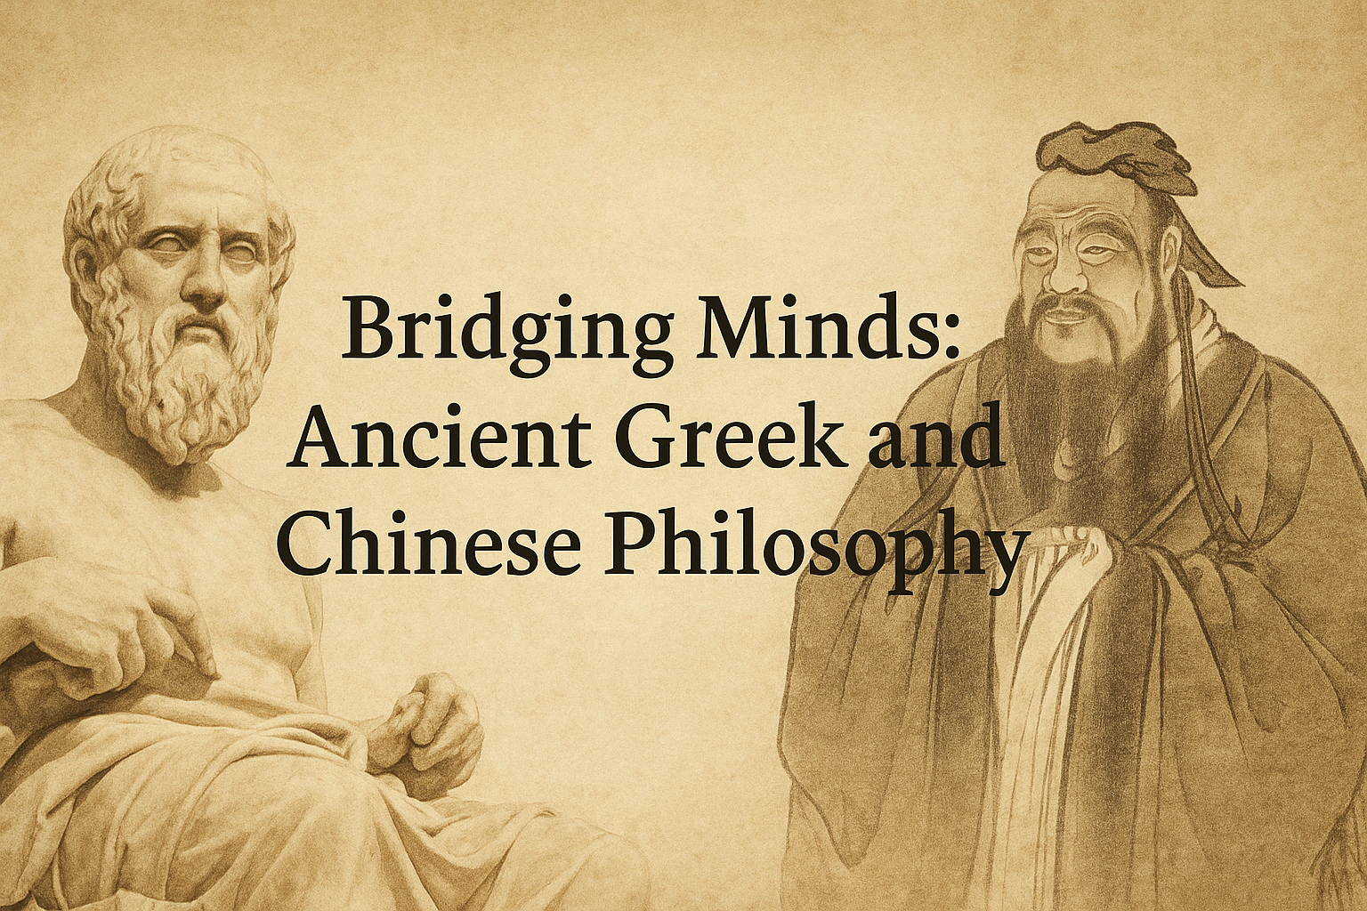
欢迎来到雅典！ Καλώς ήρθατε στην Αθήνα!
Panagiota Theodoni
Athens, July 2025

Slide 2
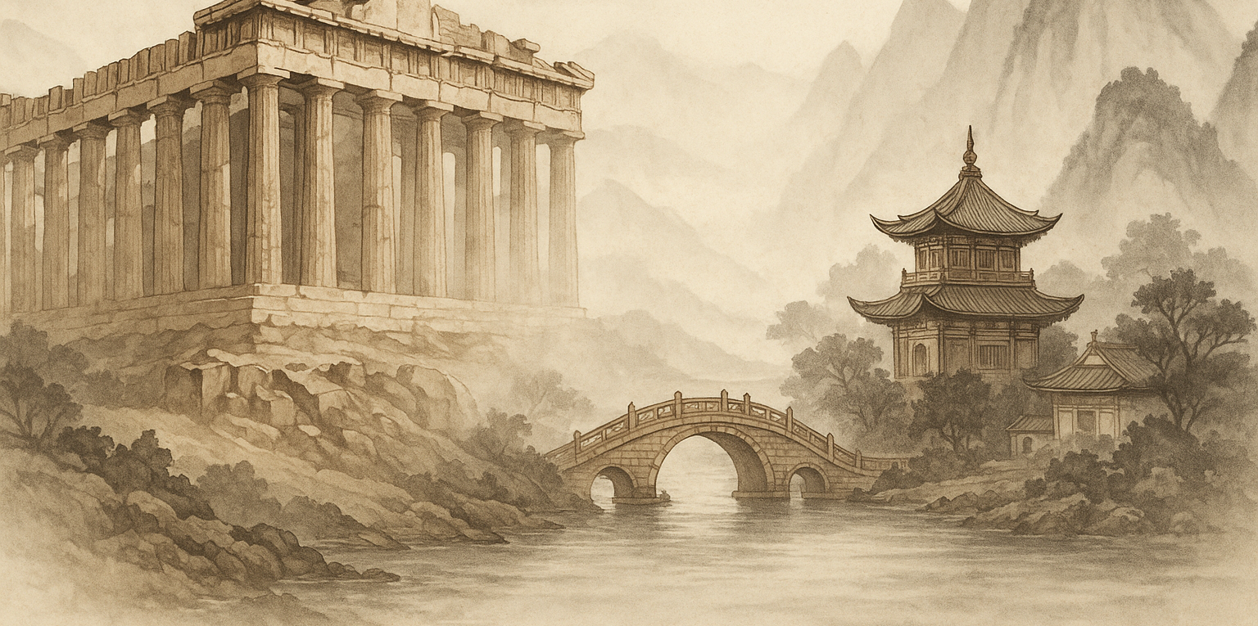
Bridging Minds: Ancient Greek and Chinese Philosophy
Wisdom across civilizations
Notes:
"Welcome everyone! 欢迎大家！Today we begin a reflective journey through two of the world’s greatest philosophical traditions: ancient Greek and Chinese philosophy. My name is [Your Name], and while I am a physicist and neuroscientist by training, I am also a philosophy student passionate about bridging disciplines and cultures.
This talk isn’t meant to be definitive or comprehensive, but rather an invitation to explore how Greek and Chinese thinkers approached big questions of life, ethics, and the cosmos. Feel free to engage, ask questions, or simply reflect."

Slide 3
Core Questions in Philosophy
What is a good life?
How should we live?
What is the nature of the world?
How do we know truth?
These questions were central to both traditions.
Notes:
"Though born in different lands, Greek and Chinese thinkers asked remarkably similar questions: What is the nature of reality? How should we live? What is knowledge? These core questions have shaped human civilizations.
Take a moment to consider: which of these questions feels most relevant to your own life right now? Philosophy, in both traditions, begins not in answers but in curiosity."

Slide 4
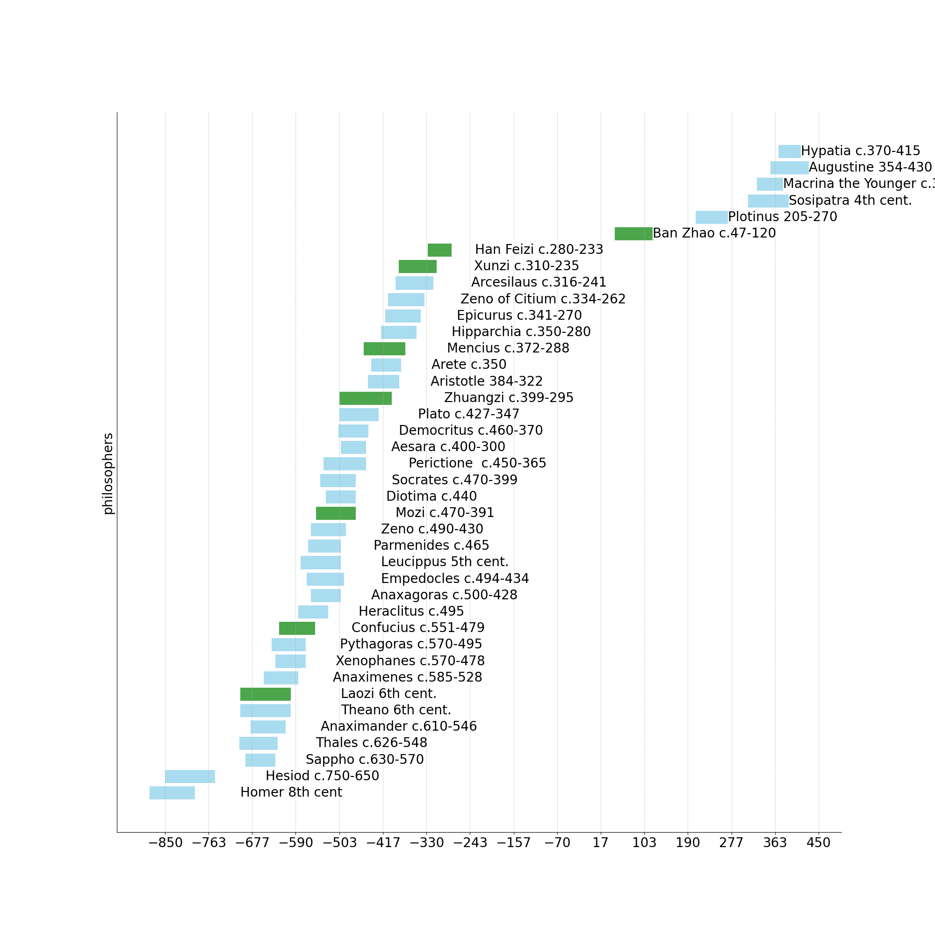
Ancient Greek and Chinese
Philosophers

Slide 5
From Mythos to Logos

Slide 6
Socrates

Slide 7
Presocratics

Slide 8
Classics
Plato & Aristotle

Slide 9
Hellenistic Period
Stoics
Epicureans
Sceptics

Slide 10
Neoplatonism

Slide 11
From Mythos to Logos
The Greeks had begun to speculate very early on metaphysical questions - the origin and nature of the universe - time and love
poems of Homer, Hesiod, Sappho
But relied on mythology and on personal experience
to provide the answers
Later, they discarded religious mythology to answer these questions and developed a secular methodology based on observation and logic
With this development came the birth of philosophy

Slide 12
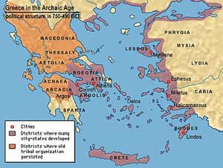
The birth of philosophy
Philosophy originated in the Greek city states along the coast of Asia Minor around 600 BC
- Because they were not as bound by tradition as city-states on mainland Greece
- Because they were also constantly in touch with the ancient science and speculation of the Middle East
They were more open to intellectual innovation and speculation than counterparts on the mainland

Slide 13
Philosophy Before Socrates
Presocratics : The First Philosophers of Nature
lived before Socrates (6th–5th c. BCE) and shifted from myth to reason.
Focused on nature, change, and the cosmos.
Asked: What is the world made of?
How does change happen?
First philosophers of natural explanation (physikoi).

Slide 14
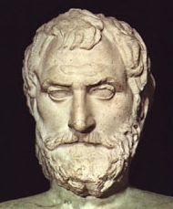
THALES OF MILETUS
Born around 625 BC
Became a well-known astronomer and correctly predicted a solar eclipse
Also developed theories about size and orbits of the sun and moon

Slide 15
THALES’ THEORY OF THE UNIVERSE
Divided all matter in the universe into two categories
Material objects
Which had their origin in water
Animate spirits
Had the ability to move on their own
We all know that his theory was wrong, but he nonetheless did something important:
Saw universe as tangible, finite, and knowable
Not a mysterious and nebulous entity that only the gods could
understand

Slide 16
THALES OF MILETUS First (West) Philosopher
Asserted that the universe could be known by men
Rejected theological and mythological interpretations of the universe and instead sought rational explanations
Opened the door for a whole new series of questions once the age-old obstacle of relying on the gods for all answers had been overcome
What is man and what is the best society for man?
What is truth and how can one recognize it?
What is virtue and how can one acquire it?

Slide 17
The Milesian School – The First Scientists
Early thinkers from Miletus who sought the substance of all things:
Thales – Everything is made of water
Anaximander – The 'Apeiron' (the Boundless) is the origin
Anaximenes – Everything is air, condensed or rarefied

Slide 18
Heraclitus of Ephesus 'Everything flows' – Panta Rhei
Philosopher of change and conflict
Believed in unity through opposites
The world is made of fire and governed by Logos (reason)
Famous quote:
'You cannot step into the same river twice.'

Slide 19
Parmenides of Elea Change is an Illusion
In contrast to Heraclitus, Parmenides argued that change is impossible
Reality is one, unchanging, eternal.
Senses are deceptive – only reason reveals truth
Famous idea: Being is, non-being is not

Slide 20
Why the Presocratics Matter
Their legacy shaped philosophy and science.
First rational explanations of the universe.
Influenced Plato, Aristotle, and later thought
Asked fundamental questions still debated today

Slide 21
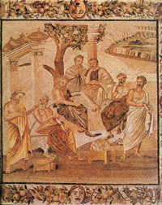
THE SOPHISTS
Greeks quickly commercialized spirit of intellectual liberation
Men trained in philosophy set themselves up as teachers of various fields
Their basic premise was that men were capable of self-improvement through education and education would make men more successful
Offered idea of human progress through one’s own efforts
Became very popular and were concentrated in Athens

Slide 22
THE SOPHISTS RHETORIC
Most popular sophists taught rhetoric
They promised that the humblest man on the street could speak in the Assembly and law courts, confound their opponents, and reap all the financial benefits of public life if they knew rhetoric
Offered to teach people how to win any arguments, regardless of the side they took
Argued that no truth is universally valid
Good and evil, truth and falsehood were matters of
individual judgment
There were no universal standards

Slide 23
Socrates (470–399 BCE) The Moral Philosopher
focused on ethics and the examined life
Left no writings — known through Plato’s dialogues
Used the Socratic Method:
asking questions to seek truth.
Famous quote: 'The unexamined life is not worth living.'
Challenged Athenian norms; executed for impiety and corrupting youth
Legacy: model of moral integrity and philosophical inquiry

Slide 24
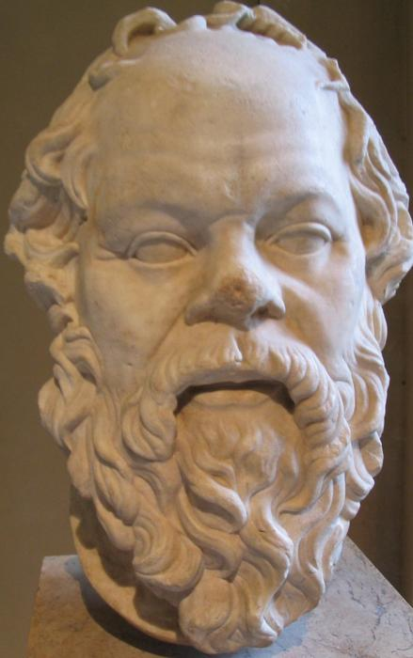
Socrates
Felt sophists had attacked old system of beliefs but had not provided a constructive replacement
Employed intellectual methodology that sophists had created to address questions that they had either neglected or ignored
Felt that sophists had taught skills but had no insight into the questions that really mattered
What is the purpose of life?
What are the values by which man should live?
How does man perfect his character?

Slide 25
Socrates
Central concern was the perfection of individual human character
Believed moral values were attained when the individual regulated his life according to objective standards arrived at through rational reflection
An individual would be able to ascertain the values necessary to live a good and just life when reason became the formative, guiding, and ruling agency of the soul
True education meant the shaping of character according to values discovered through the active and critical use of reason

Slide 26
Socrates The Power of Reason
Socrates taught that rational inquiry was a priceless took that allowed one to test opinions, weigh the merit of ideas, and alter beliefs on the basis of knowledge
Believed that when people engaged in critical self-examination and strove to perfect their characters, they liberated themselves from accumulated opinions and traditions and based their conduct instead on convictions they could rationally defend

Slide 27
Socrates Socratic Method
Believed that knowledge was innate in the human mind
To extract it out into the conscious, he developed a question-and-answer method
Attracted loyal audience of young men
Mostly from well-off families
Encouraged them to debate the most fundamental concepts of human behavior in an attempt to define the guidelines of ethical conduct

Slide 28
Socrates Socratic Method
Would begin debates with students with searching questions into traditional assumptions that everyone took for granted and then proceed to show that these assumptions were rooted more in custom and prejudice than they were in logic
Would then lead students (with more questions) into developing more precise definitions of such concepts as piety, justice, good, and evil
He never formulated rules of conduct.
Instead he believed that by giving his followers the habits of
rigorous questioning and logical though processes, he was creating a mentality that could perceive correct conduct under all conditions

Slide 29
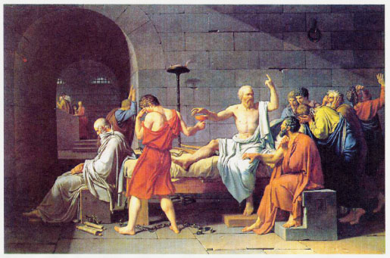
Socrates
Most in Athens dismissed Socrates as a eccentric sophist
But his students developed a fanatical loyalty to him
Political leaders, whose ability and judgment he continually questioned, hated his guts
some enemies brought Socrates to trial on charges of “corrupting the youth of Athens”
Socrates denied charges but refused to grovel and beg forgiveness
Was found guilty and ordered to kill himself by drinking hemlock
He refused to alter his principles and drunk it

Slide 30
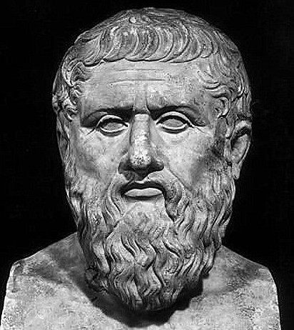
Plato (427–347 BCE) The Idealist - World of Ideas
student of Socrates, founded the Academy in Athens
Developed the Theory of Forms — eternal, perfect ideals beyond the physical world
Wrote dialogues: Republic, Symposium, Phaedo, etc
The Allegory of the Cave: knowledge through philosophical enlightenment
Believed philosopher-kings should rule
Emphasized reason, education, and the soul’s immortality

Slide 31
Plato The World of Ideas
Truth resides in the World of Ideas. Not in the world made known through the senses
People form opinions of beauty or justice from observing what they think is beautiful or just in the material world
But since nothing is perfect in the material world, this opinion is distorted and imperfect
One who aspires to true knowledge must go beyond sensory perception and try to grasp with their mind the Idea of Beauty or Justice in the World of Ideas
Plato saw the material world as unstable, transitory, and imperfect while the World of Ideas was eternal and universally valid
True wisdom is obtained through knowledge of the Ideas, not the imperfect reflection of these Ideas that we perceive with the senses

Slide 32
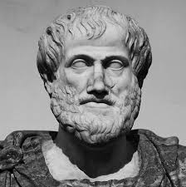
Aristotle (384–322 BCE) The Empiricist
student of Plato, tutor of Alexander the Great,
Founded the Lyceum
Studied biology, logic, ethics, politics — founder of many sciences
Rejected Plato’s Forms; believed knowledge comes from observation
Ethics: the 'Golden Mean' — virtue lies between extremes
Politics: best government balances monarchy, aristocracy, and democracy
emphasized classification and logic

Slide 33
Virtue and the Good Life in Greece
Socratic ethics: "The unexamined life is not worth living"
Aristotle: eudaimonia (flourishing)
golden mean
"Knowing yourself is the beginning
of all wisdom."
自知之明是智慧的开始

Slide 34
Ancient Greek Philosophy Overview
Pre-Socratics
Heraclitus - change Pythagoras - order
Socrates - questioning, ethics
Plato - ideal forms, the soul
Aristotle - virtue, logic, purpose

Slide 35
Wisdom across civilizations

Slide 36
Ancient Chinese Philosophy 哲学 (zhéxué) study of wisdom
Chinese philosophy emerged during the Eastern Zhou dynasty, particularly the Warring States period
Focused on harmony, morality, governance, and nature
The 'Hundred Schools of Thought' flourished around 6th–3rd century BCE
Major traditions:
Confucianism, Daoism, Mohism, Legalism

Slide 37
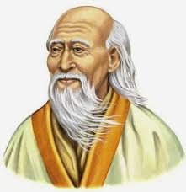
Laozi (6th c. BCE) The Philosopher of the Dao
Laozi is credited with writing the
Dao De Jing (道德经)
Dao (道): the natural way
of the universe
Wu Wei (无为): non-action or effortless action in harmony with nature
Valued simplicity, humility, and natural order over rules and ambition
Influenced Chinese art, medicine, politics, and spirituality

Slide 38
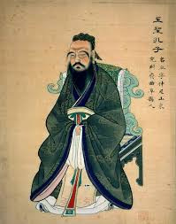
Confucius (551–479 BCE) The Teacher of Humanity
emphasized ethics, education, and social harmony
Core virtues:
Ren (仁, benevolence)
Li (礼, ritual propriety)
Yi (义, righteousness)
Stressed filial piety and moral leadership
Believed good society starts with cultivation of virtue
Collected teachings in the Analects (论语)

Slide 39
Mencius and Xunzi Confucian Debate
Two major Confucian thinkers with contrasting views of human nature
Mencius (孟子): Humans are naturally good;
society should nurture this
Xunzi (荀子): Humans are naturally selfish;
need ritual and education to be good
Both emphasized moral education and virtuous leadership

Slide 40
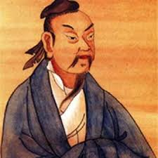
Zhuangzi (4th c. BCE) The Free Spirit of Daoism
Zhuangzi used stories and paradoxes
to express Daoist philosophy
Emphasized spontaneity,
freedom from rigid thinking
Questioned absolute knowledge and distinctions
Famous story: the butterfly dream – reality and illusion are relative
Daoism as liberation from social roles and rigid values.

Slide 41
Mohism and Legalism Alternative Schools
Other influential traditions in Chinese thought
Mozi (墨子): Universal love (Jian Ai 兼爱), meritocracy, opposition to war
Legalism (Han Feizi 韩非子): Strong laws and punishments; humans need control

Slide 42
Confucian Ethics and Cultivation
Focus on family, community, social harmony
Lifelong self-cultivation
Quote: "君子和而不同"
The gentleman seeks harmony, not uniformity

Slide 43
Daoism and the Nature of Change
Dao as the natural way
Embrace of paradox, flow, mystery
Quote: 道可道，非常道
The Dao that can be spoken is not the
eternal Dao

Slide 44
Comparison and Legacy
Chinese philosophy shaped not only China but much of East Asia
Confucianism: foundations of education, family, state
Daoism: harmony with nature, health practices, mysticism.
Philosophy as practical wisdom for daily life and governance.
Continues to influence modern ethics, politics, and spiritual thought.

Slide 45
Chinese Philosophy – Overview
Confucius (Kongzi): 礼 (li) ritual
仁 (ren) humaneness
Laozi: 道 (Dao) the way
无为 (wu wei) non-action
Zhuangzi: spontaneity, freedom from rigid categories

Slide 46
Wisdom across civilizations
Comparative Insights

Slide 47
Comparative Insights Greek & Chinese Philosophy
Let’s explore how two great traditions approached ethics, metaphysics, and knowledge
This section encourages reflection, not judgment — finding resonance and contrast

Slide 48
Virtue Ethics Aristotle and Confucius
Aristotle: Ethical virtues through rational moderation (the golden mean)
Confucius: Ethical roles and moral cultivation through ritual (li) and humaneness (ren)
Both aimed at personal excellence and social harmony.

Slide 49
Logos and Dao: Order in the Cosmos
Greek: Logos as rational order
Chinese: Dao as dynamic way
Both articulate an underlying structure, but one is analytic, the other poetic.

Slide 50
Methods of Inquiry: Dialectic vs. Analogy
Socratic Method: Questioning to expose contradictions
Confucian Method: Teaching through parables, historical analogy
Greek emphasis on critique
Chinese on harmonizing tradition

Slide 51
Change and Constancy: Heraclitus and Zhuangzi
Heraclitus: “Everything flows” (Panta Rhei)
Zhuangzi: Reality is dreamlike, flowing, paradoxical
Both challenge fixed categories and embrace becoming

Slide 52
Philosophy and Society
Greek: Public debate, independent schools
Chinese: Scholar-officials, moral governance
Philosophy as civic virtue vs. Confucian moral-political integration.

Slide 53
Bridges Between Traditions
Heraclitus and Laozi: change, flow, mystery
Confucius and Aristotle: ethics, virtue, cultivation
Socratic method vs. Confucian guidance

Slide 54
Common Ground: The Reflective Life
Despite cultural and historical distance:
Both valued self-knowledge, ethics, and harmony
Both shaped political theory, education, and science

Slide 55
Dialogue Across Cultures
No single truth — only deeper understanding
Philosophy as bridge-building,
not competition
对话而不是对抗
Dialogue, not confrontation

Slide 56
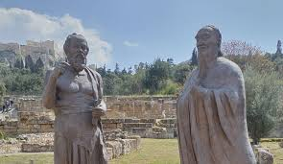
谢谢大家！

